Slide 1


A NEW ENCRYPTION TECHNIQUE PCS21-42
Mentor: Mr. Hriday Kumar Gupta
Team: Himanshu Yadav, Kartikeya Yadav

Slide 2
INTRODUCTION
As increase in the technology like IOT and Cloud computing the demand of data security is also increasing. Here the encryption algorithms came into existence. It is necessary that the algorithms must be secured and efficient so that it can also be transmit over the network, some popular one’s available to use are AES, DES, TRIPLE DES, BLOWFISH, RC5 etc. In this report we will see how various encryption techniques are work and a new encryption technique is implemented on the data to make it more efficient than the available encryption techniques.

Slide 3
CRYPTOGRAPHY
Cryptography refers to a method of protecting information and communications through the utilization of codes, in order that only those for whom the knowledge is meant can read and process it. The message to be sent through an unreliable medium is understood as plaintext, which is encrypted before sending over the medium. The encrypted message is understood as cipher text, which is received at the opposite end of the medium and decrypted to urge back the first plaintext message.

Slide 4
ENCRYPTION
Encryption is a process of encoding a message or a file so that it can be only be read by certain people. Encryption uses an algorithm to scramble, or encrypt, data and then uses a key for the receiving party to unscramble, or decrypt, the information.

Slide 5
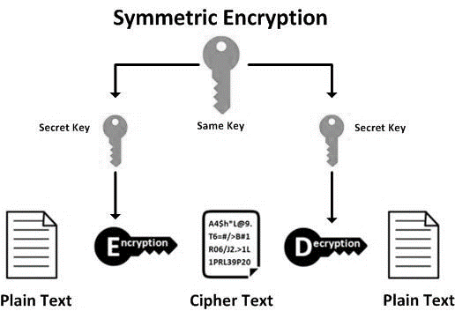
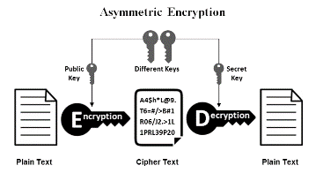
TYPES OF ENCRYPTION
Symmetric Encryption
Asymmetric Encryption

Slide 6
ENCRYPTION ALGORITHMS
An encryption algorithm is a method of transforming data into ciphertext. An algorithm use the encryption key in order to alter the data in a predictable way, so that even though the encrypted data will appear randomly, it can be turned back into plaintext by using the key. Various Encryption Algorithms are:
AES
DES
TRIPLE DES
BLOWFISH
RC5.

Slide 7
Performance Analysis & Comparison of above Algorithms
File Size | AES | Blowfish | DES | DES3 | CAST5
1KB | 7.64513 | 9.810925 | 11.72828674 | 2.525568 | 11.22761
10KB | 13.26418 | 15.20085 | 13.70382309 | 10.58197 | 18.69273
100KB | 21.76523 | 25.07901 | 22.65381813 | 14.020681 | 30.69544
1MB | 25.15554 | 20.05696 | 24.72162247 | 47.610521 | 34.82008
10MB | 51.06378 | 118.5479 | 176.3219833 | 414.85858 | 171.4973

Slide 8
File Size | AES | Blowfish | DES | DES3 | CAST5
1KB | 5.138159 | 18.71228 | 16.99138 | 45.16554 | 33.0441
10KB | 14.9889 | 18.85891 | 27.63176 | 19.91558 | 14.93025
100KB | 15.2781 | 18.50033 | 31.56424 | 37.86397 | 14.76693
1MB | 22.6512 | 31.07595 | 37.49347 | 47.98007 | 46.04673
10MB | 58.94041 | 120.6176 | 179.8019 | 424.9966 | 166.2364

Slide 9
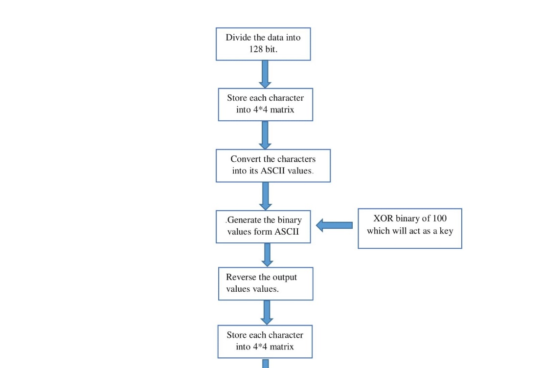
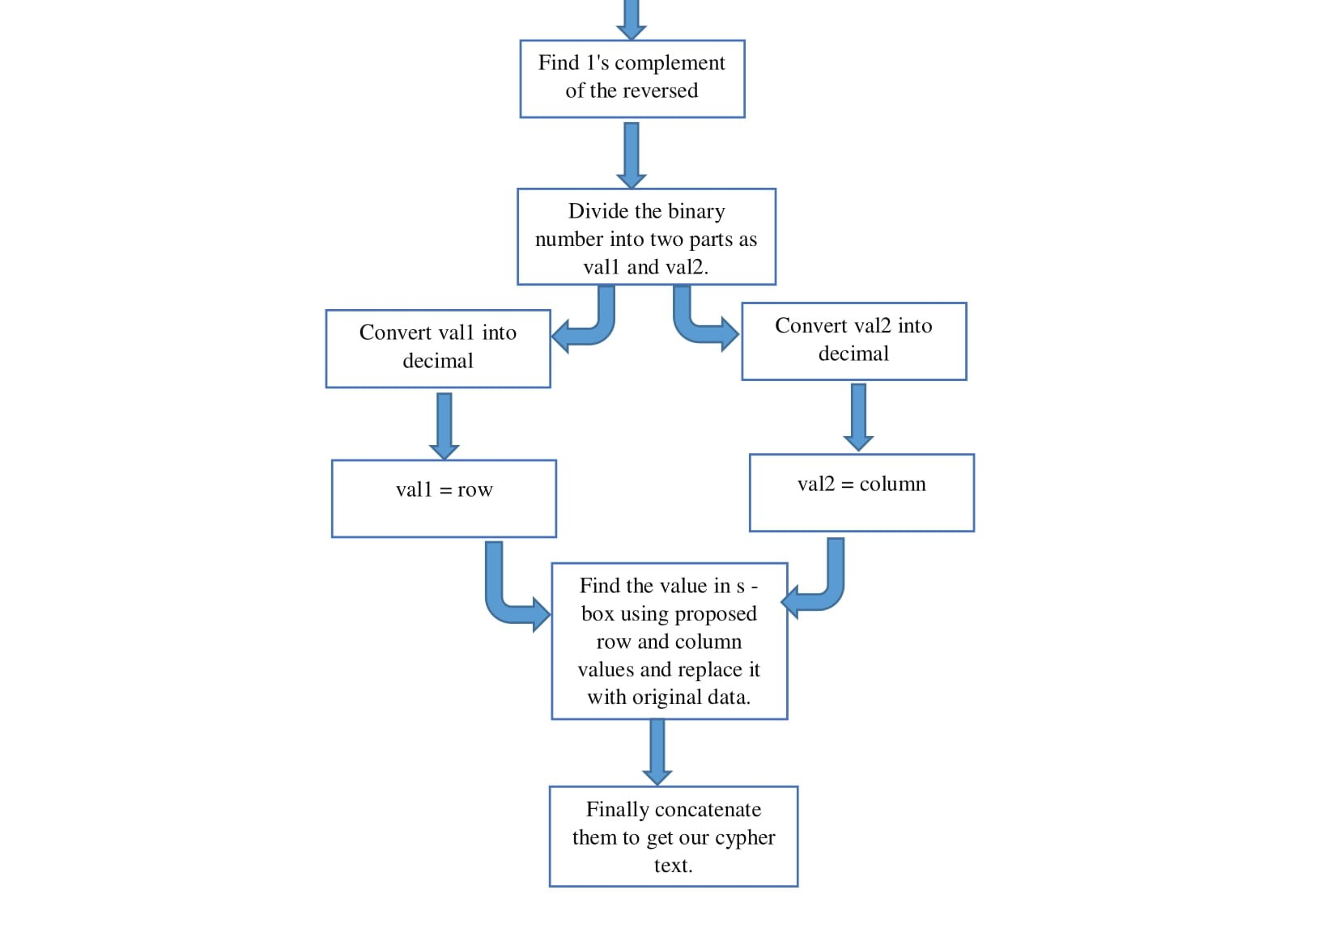
PROPOSED ALGORITHM
Encryption Flowchart

Slide 10
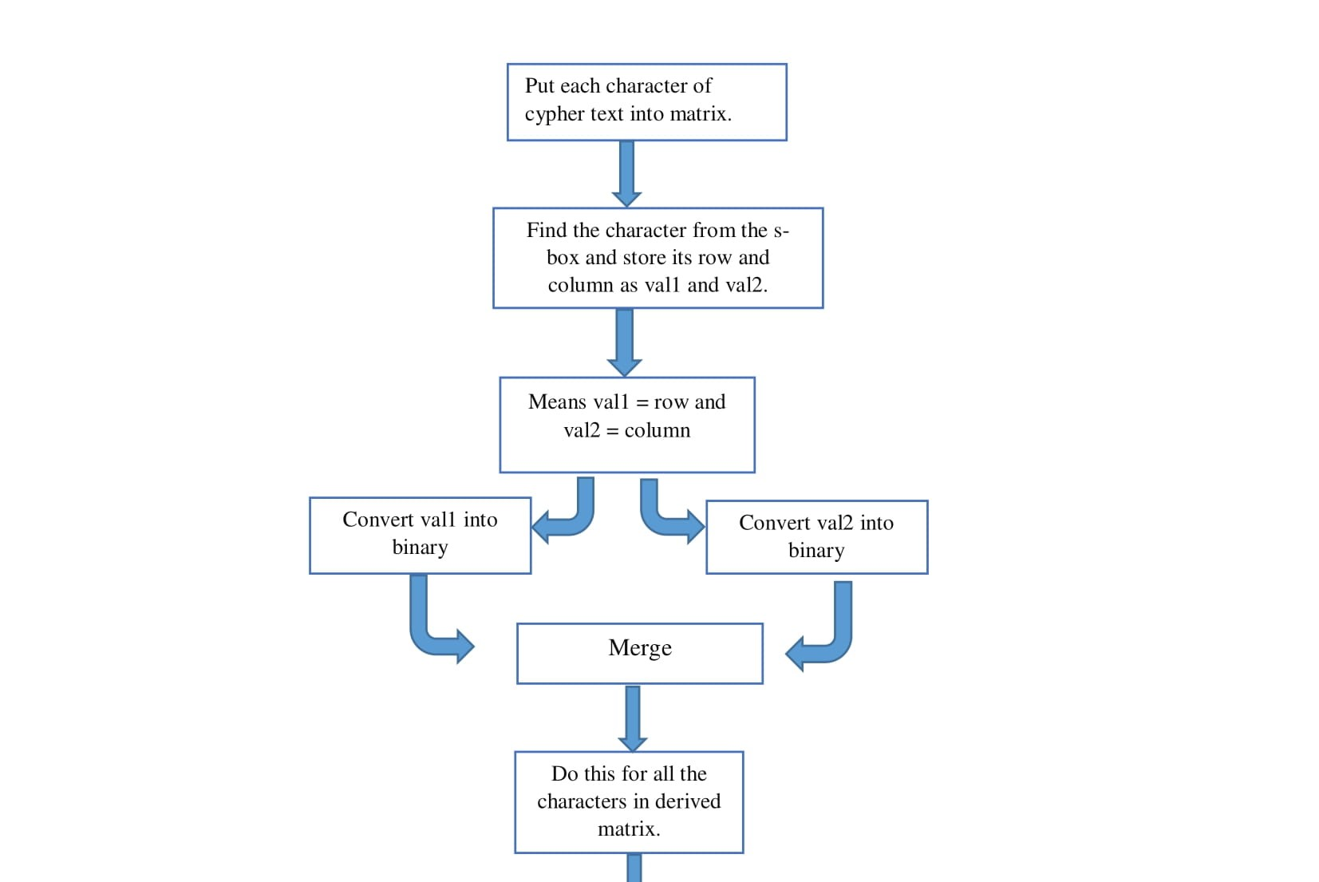
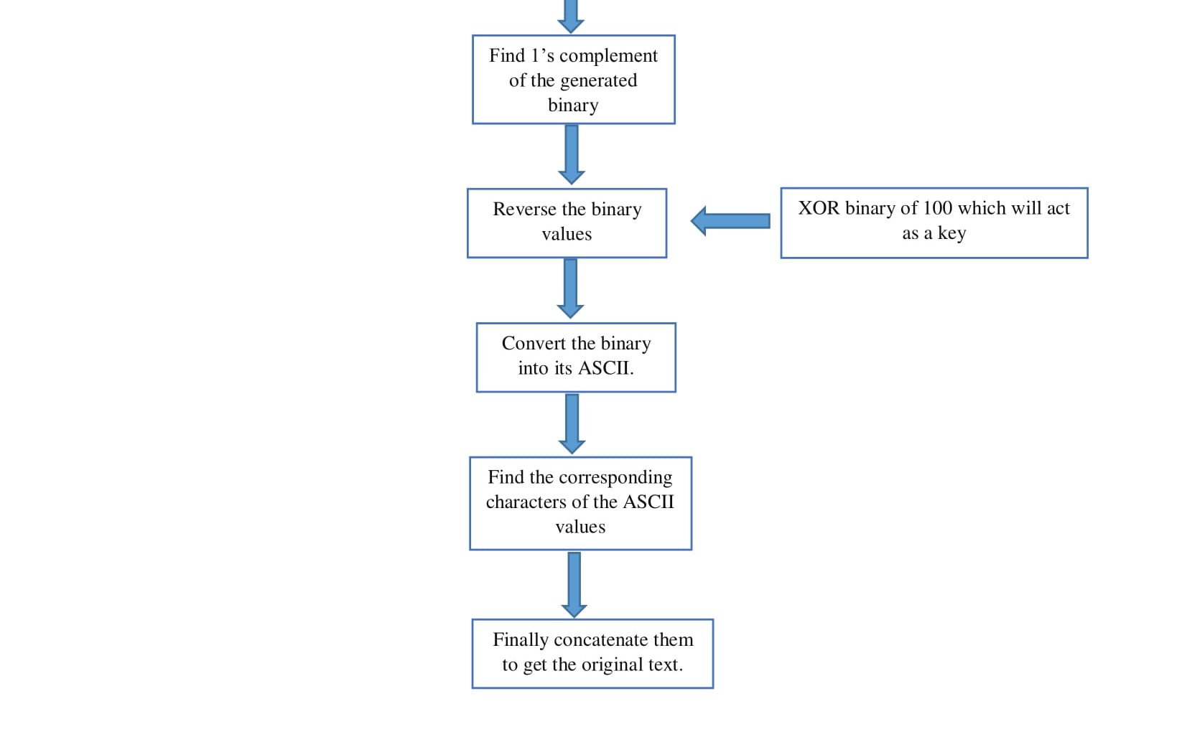
Decryption Flowchart

Slide 11
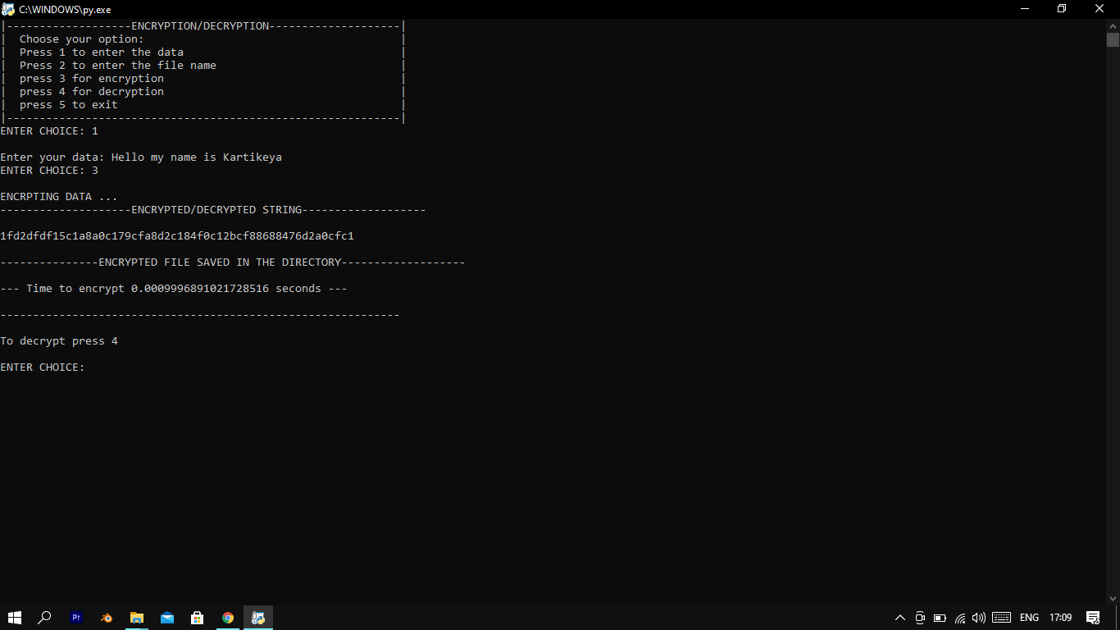
Encrypting text data

Slide 12
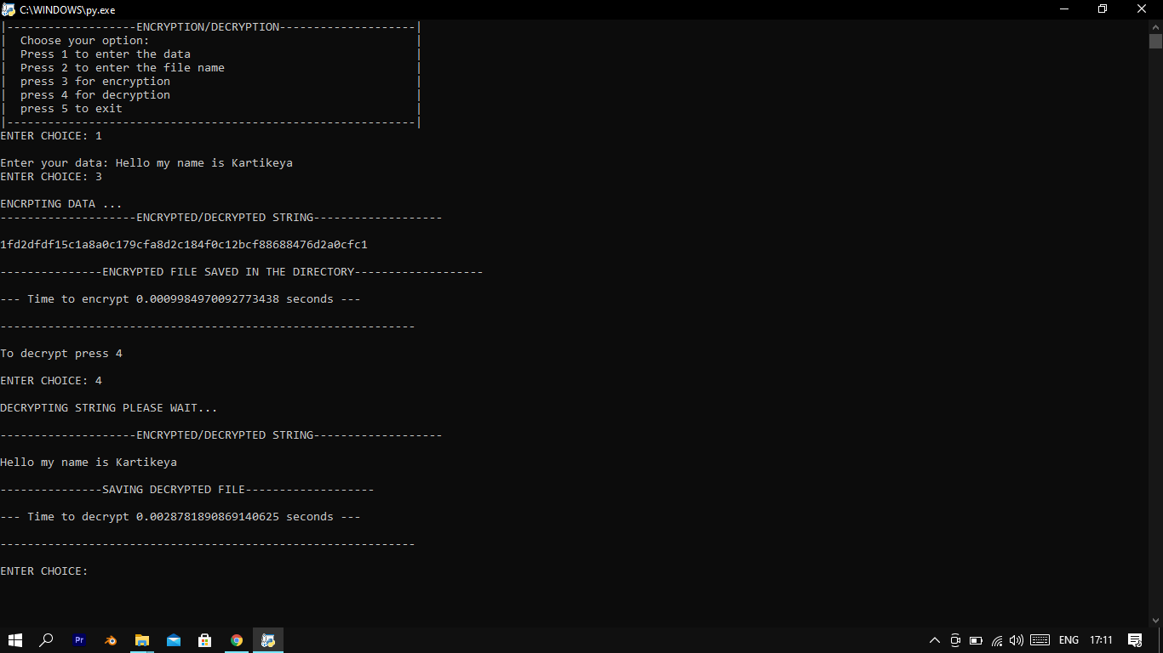
Decrypting text data

Slide 13
Achievement
Research Paper: “A new encryption technique”, to be showcased in 3rd International Conference on Frontiers of Science and Technology-2021 (ICFST-2021) scheduled on August 13-14, 2021.

Slide 14
Advantages
Good for small network.
Data Specific.
Fast and easy to implement.
Flexible (Can be modified easily).

Slide 15
CONCLUSION
Cryptography is processed to convert a plain text into non-understandable unreadable text and encryption helps us to achieve this, hence encryption algorithms play very important role in communication security. Before sending any confidential data, it must be encrypted so that it remains protected from the attackers or from the unauthorized access over the network. This Paper has a new encryption technique which is very simple in nature with a less execution time.

Slide 16
REFERENCES:
Comparative analysis of encryption algorithms for better utilization. (Anuj Kumar, Sapna Sniha, Rhaul Chaudhary. International Journal of computer application (0975- 8887). Volume 71, 14th May 2013. https://en.wikipedia.org/wiki/Triple_DES
Idrizi, Florim, Dalipi, Fisnik & Rustemi, Ejup. “Analyzing the speed of combined cryptographic algorithms with secret and public key”. International Journal of Engineering Research and Development, e-ISSN: 2278-067X, p-ISSN: 2278-800X, www.ijerd.com Volume 8, Issue 2 (August 2013), pp. 45
Jawahar Thakur, Nagesh Kumar, “ DES, AES and Blowfish: Symmetric Key Cryptography Algorithms Simulation Based Performance Analysis,“ in International Journal of Emerging Technology and Advanced Engineering (ISSN 2250-2459, Volume 1, Issue 2, December 2011), pp.6-12.
S.Pavithra, Mrs. E. Ramadevi “study and performance analysis of cryptography algorithm” International Journal of Advanced Research in Computer Engineering & Technology Volume 1, Issue 5, July 2012 14, pp.82-86.
Nagesh Kumar, Jawahar Thakur, Arvind Kalia on “performance analysis of symmetric key cryptography algorithms DES, AES and blowfish “ in AnInternational Journal of Engineering Sciences ISSN: 2229-6913 Issue Sept 2011, Vol. 4 ,pp.28-37.
Dr. Prerna Mahajan & Abhishek Sachdeva on “A Study of Encryption Algorithms AES, DES and RSA for Security” Global Journal of Computer Science and Technology Network, Web & Security Volume 13 Issue 15 Version 1.0 Year 2013

